Slide 1
LUNG CANCER RISK PREDICTION
OLAGUNJU AYOMIDE

Slide 2
PROJECT BREAKDOWN
Introduction
Project Objectives and Expected Outcomes
Data Cleaning and Preprocessing
Exploratory Data Analysis (EDA)
Feature Selection
Model Building and Evaluation
Best Model Deployment with Streamlit
Recommendations
Conclusion

Slide 3
INTRODUCTION
This project focuses on developing a machine learning model to predict lung cancer risk based on patient health indicators and lifestyle factors.
PROJECT OBJECTIVES
To obtain the best model that most performed when compared to other regression models
To develop a Predictive Model can identify patterns and correlations between risk factors and the likelihood of developing lung cancer.
To Enable Personalized Risk Assessment and Support Early Intervention
To provide an interactive user-friendly interface via streamlit for ease of deployment and usage.
EXPECTED OUTCOME
The major outcome of this project is to create a model capable of calculating precise probabilities of lung cancer risk for individual patients & Provide healthcare professionals with tools to identify high-risk patients early, enabling proactive care and reducing late-stage cancer diagnoses.

Slide 4
DATASET OVERVIEW
Total Records: 5,000
Features: 18 variables capturing lung cancer risk factors.
Demographics: Age and gender.
Lifestyle: Smoking history, alcohol consumption, and stress levels.
Medical History: Pre-existing conditions, family history of lung cancer.
Symptoms: Breathing issues, chest tightness, oxygen saturation.
Target Variable: Pulmonary Disease (binary outcome indicating lung cancer risk).
Relevance: Variables combined to form a predictive risk profile for machine learning.
Problem Type: Regression problem, focusing on predicting the likelihood of lung cancer based on input features.

Slide 5
DATA CLEANING & PREPROCESSING
DATA CLEANING
Check for Duplicate data
Check for Incorrect data types
Check for Missing data
Check for Negative values
Check for Special characters
Check for Outliers:
Outlier Treatment: Outliers detected in Energy level were handled using the IQR method combined with Winsorization:
Boundaries: lower (Q1−1.5×IQR) and upper (Q3+1.5×IQR) bounds.
Extreme values were capped at these limits to reduce their impact while retaining data integrity

Slide 6
DATA CLEANING & PREPROCESSING
DERIVING ADDITIONAL FEATURES
Derived new features to enhance predictive accuracy: ‘Inverse Energy Level’, ‘Inverse Oxygen Saturation’. They were Calculated as the of reciprocal energy level and oxygen saturation. These transformations were applied to capture the nonlinear relationships between the original variables and lung cancer risk.
Balancing: Addressed class imbalance using SMOTE to ensure the model is trained on an equitable representation of cases with and without pulmonary disease.
Scaling: Standardized feature values to improve model performance and convergence during training using MinMaxScaler

Slide 7
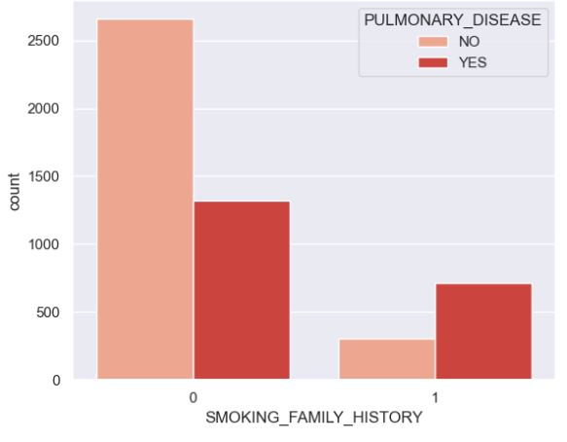
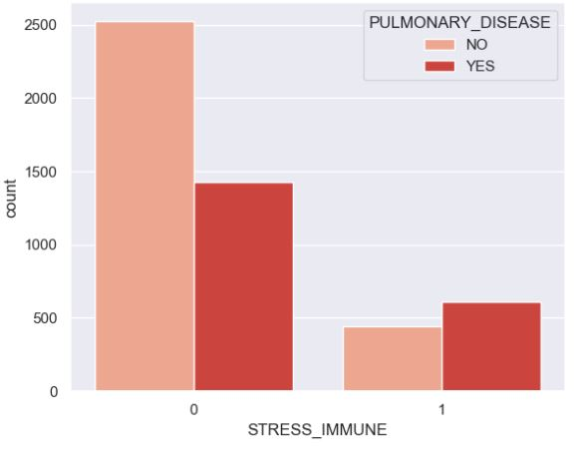
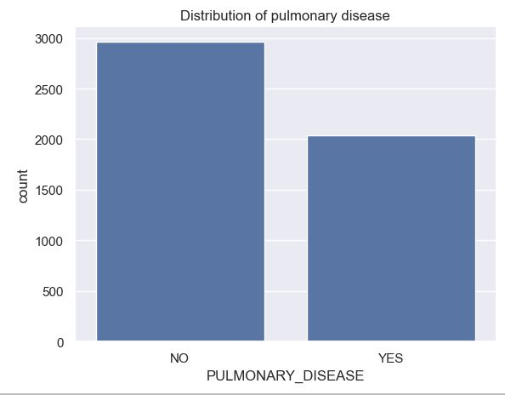
EXPLORATORY DATA ANALYSIS (EDA)
Pulmonary Disease vs Smoking family history
Pulmonary Disease vs Stress Immune
TARGET VARIABLE ANALYSIS
The dataset is not extremely imbalanced but the difference is notable.
SUMMARY ANALYSIS OF STRESS IMMUNE
Most people without stress immune(0) have pulmonary disease and a higher proportion of people with stress immune have pulmonary disease compared to those without. This suggests that stress immune appears to be linked to pulmonary disease but they are not the only factor
SUMMARY ANALYSIS OF SMOKING FAMILY HISTORY
While more individuals without a smoking family history (0) have pulmonary disease, a larger proportion of individuals with a smoking family history exhibit pulmonary disease
This indicates that a smoking family history is a strong predictor and risk factor for pulmonary disease.

Slide 8
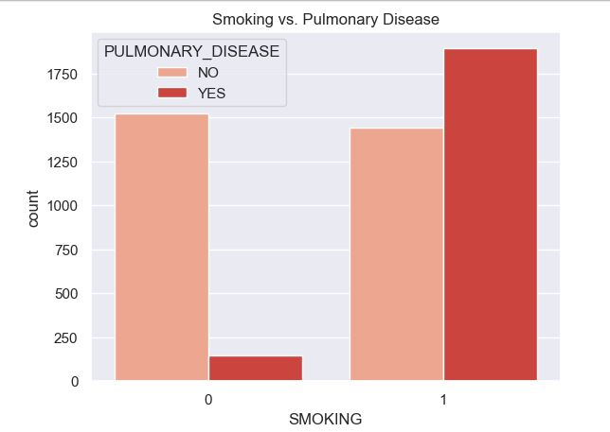
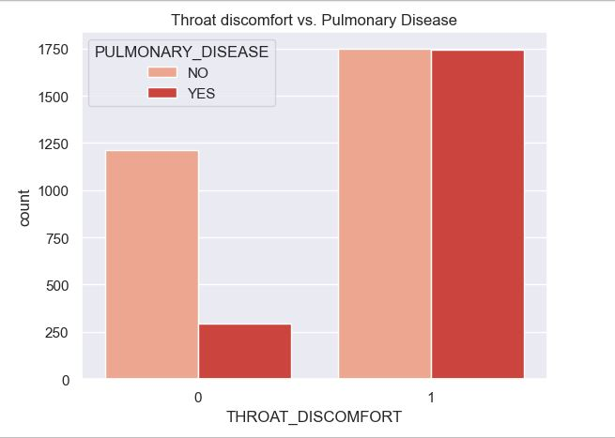
EXPLORATORY DATA ANALYSIS (EDA)
SUMMARY ANALYSIS OF SMOKING VS PULMONARY DISEASE
Non smokers(0) have lower cases of pulmonary disease. However, smokers have more "YES" cases than "NO", therefore, smoking is a major risk factor for Pulmonary Disease. smoking is a predictor of pulmonary disease
SUMMARY ANALYSIS OF THROAT DISCOMFORT VS PULMONARY DISEASE
Without Throat Discomfort: Individuals are more likely to be disease-free, suggesting that throat discomfort might be a potential risk indicator for pulmonary disease.
With Throat Discomfort: An equal number of cases with and without pulmonary disease indicates that throat discomfort alone does not strongly differentiate between the two groups.

Slide 9
FEATURE SELECTION
OBJECTIVE OF FEATURE SELECTION
To select the most relevant features that contribute significantly to lung cancer risk prediction.
METHOD USED
Performed correlation analysis to detect multicollinearity
Trained an interim Decision Trees and Random Forest models to access feature importance
The selected features include: Smoking, Inverse energy level, Breathing issue, Throat discomfort, Stress immune, Inverse Oxygen Saturation, Age, Exposure to pollution, Smoking family history and Gender
OUTCOME
The feature selection process helped reduce noise, improved model accuracy and enhanced the interpretability of the final project.

Slide 10
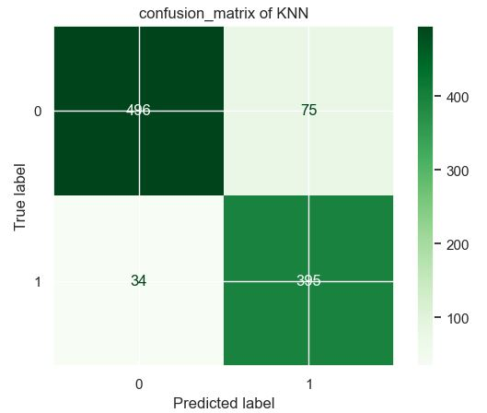
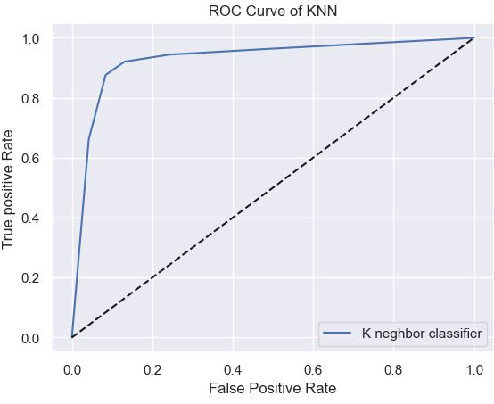
In this project, multiple machine learning models were trained to predict lung cancer risk. They are Logistic Regression, K-Nearest Neighbors (KNN), Random Forest and Decision Tree. The key performance metrics used in this project are: Precision: The proportion of correctly predicted positive cases out of all predicted positive cases. It indicates the accuracy of positive predictions. Recall: The proportion of actual positive cases correctly identified by the model. It measures how well the model captures positive instances. F1 Score: The harmonic mean of precision and recall, balancing both metrics to provide an overall measure of model performance.
MODEL BUIDING AND EVALUATION
SUMMARY ANALYSIS OK K-NEAREST NEIGHBORS
Precision - 0.84
Recall - 0.92
F1 score - 0.88
The model demonstrates strong performance, particularly in identifying high risk patients.
The AUC-ROC curve demonstrates high performance, as evidenced by the steep rise in the curve, indicating a good balance of sensitivity and specificity.

Slide 11
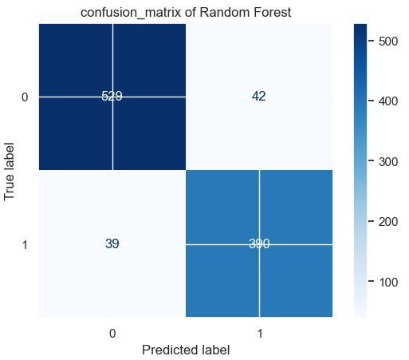
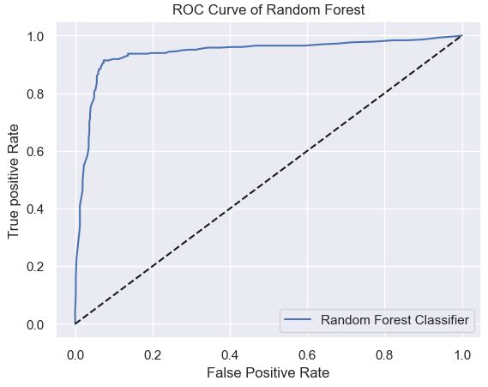
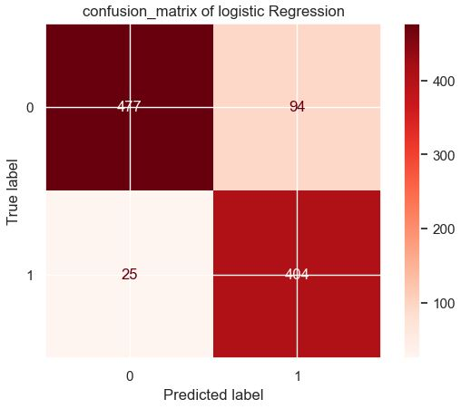
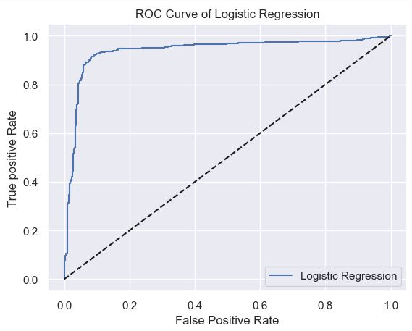
MODEL BUIDING AND EVALUATION
SUMMARY ANALYSIS OF RANDOM FOREST
Precision - 0.90
Recall - 0.91
F1 score - 0.91
The model demonstrates a strong balance between correctly identifying high risk patients and minimizing false predictions
The AUC-ROC curve shows that the model effectively distinguishes between classes, as indicated by the ROC curve's steep rise and proximity to the top left corner. This showcases its high accuracy in predicting true positives while minimizing false positives
SUMMARY ANALYSIS OF LOGISTIC REGRESSION
Precision - 0.81
Recall – 0.94
F1 score - 0.87
The model demonstrates a strong recall, effectively identifying most at risk patient, with a reasonable precision and overall balanced performance
The AUC-ROC curve demonstrates the model's strong performance in classification tasks. The curve's position above the diagonal baseline indicates effective discrimination between positive and negative classes, reflecting a good balance between sensitivity and specificity.

Slide 12
BEST MODEL DEPLOYMENT WITH STREAMLIT
Logistic Regression model was selected for deployment due to its optimal performance in identifying high risk patients with a focus on maximizing recall (0.94) and a strong F1 (0.87) indicating a balanced performance in identifying high risk patients making it the most reliable model for minimizing false negatives and ensuring that most high risk patients were detected. This aligns with the project’s goal of prioritizing safety by reducing missed risk cases.
The selected model was deployed using streamlit, a python framework for building interactive web applications, allowing healthcare professionals to input patient’s data and obtain real-time risk assessment
The app provides probability-based predictions of lung cancer risk, ensuring informed decision-making in clinical settings.
Below is the link to the streamlit web application:
https://lung-cancer-prediction-app-dzqppsagpduascbj8zbdf8.streamlit.app/

Slide 13
RECOMMENDATIONS
RECOMMENDATION
Enhance data quality and diversity: Incorporate additional features such as genetic markers and radiological data to improve model accuracy and capture deeper risk factors
Regular model updates: While the model’s precision is not harmful in the context of lung cancer risk prediction- where identifying as many true cases as possible is critical, further refinements is recommended to reduce false positives and improve overall reliability
Expand real-world testing: Validate the model in clinical settings with real patient data to assess practical performance and identify areas for refinements
LIMITATION
Precision-Recall Trade-Off: A priority was placed on recall which led to some loss in precision. Future iterations may focus on optimizing precision if reducing false positives becomes more critical.
Data Quality & Availability: The model was trained on a specific dataset that may not represent the full diversity of patient populations in real-world healthcare settings

Slide 14
CONCLUSION
This project successfully deployed a logistic regression model for lung cancer risk prediction, prioritizing recall to ensure the identification of high risk patients. While the model’s precision was lower, the emphasis on recall minimizes false negatives, which is crucial in healthcare applications where early detection is vital.
The streamlit web application offers a practical solution for real-time predictions, aiding healthcare professionals in making informed decisions. Continuous model evaluation and updates, along with the integration of additional features, are recommended for further improvement and long-term accuracy

